Slide 1



Student Success Coaches
Debra Bastow & Arran Hurley

Slide 2
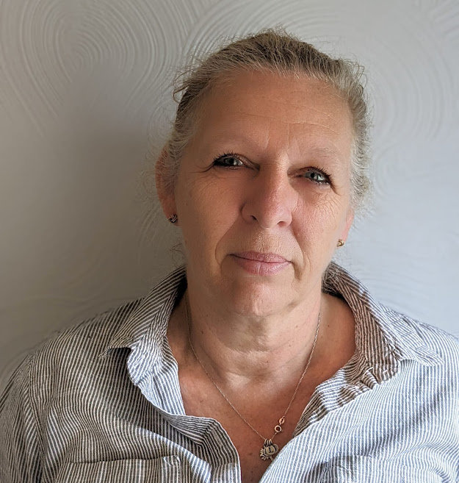
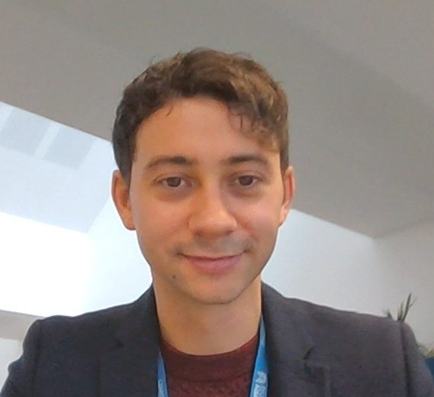
Student Success Coaches
Debra Bastow
Student Success Coach
Arran Hurley
Student Success Coach

Slide 3
What we do
Our role is to help you get the most out of your university experience. We offer 1-1 support to help you achieve your goals. This can be through:
Accessing and navigating university services;
Supporting you develop short and long term goals;
Help you develop as an individual in areas such as organization, time management, confidence, and resilience.

Slide 4
How to contact us
Link: https://enrol.coventry.ac.uk/enrolmentportal
Drop-in desks
Debra Bastow
ECB (Frank Whittle building) Thursdays 10:00 – 13:00
John Laing Thursdays 13:00 – 16:00
*Starting in February, ECB /BSB Wednesdays & Thursdays 16:00 – 18:00
Arran Hurley
ECB (Frank Whittle building) Tuesdays 10:00 – 13:00
John Laing building Wednesdays 13:00 – 16:00

Slide 5
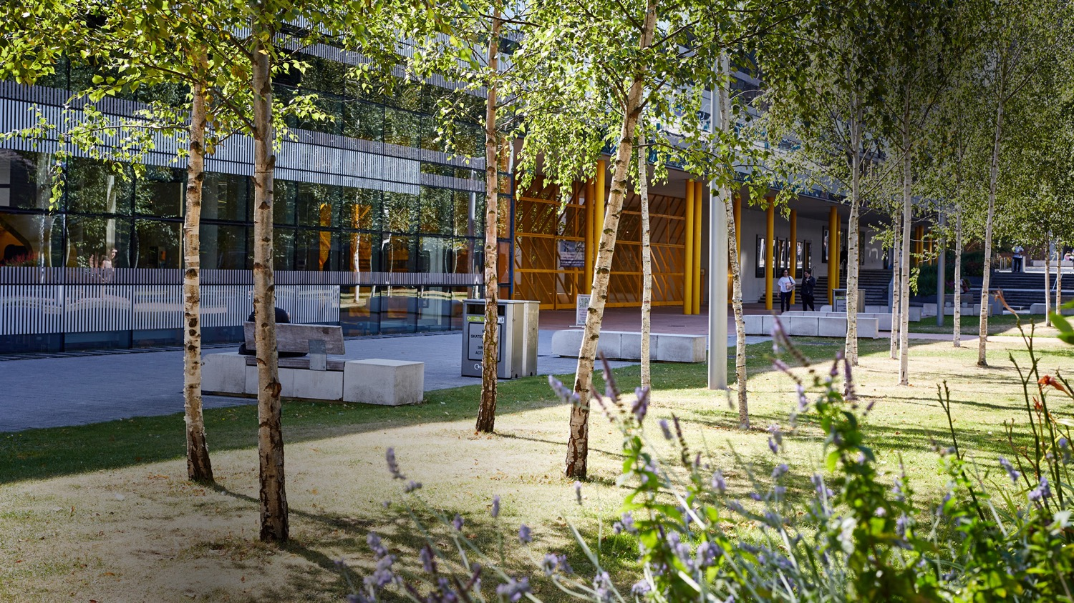
Any questions?

